Slide 1
Careers in Psychology
UMBC Psychology at
The Universities at Shady Grove

Slide 2
Today’s Topics
Passion:
  What are the benefits of a liberal arts education?
  What are the main areas of study in Psychology?
  What are some careers in Psychology?
Path:
  The undergraduate degree and beyond…
    What is the difference between B.A. and a B.S. degree?
    What is the value added by getting Master’s degree vs. a Doctoral Degree?
    What are the differences between a Ph.D. and a Psy. D.?
Plan:
  What is your plan?
  What can you do to make the most of your opportunities?
Q&A
Notes:
Small Group

Slide 3
Passion
Path
Plan

Slide 4
The Value of a Liberal Arts Education
Provides a well-rounded experience
Skills include:
  Communicating:
    Reading and Writing
    Listening and Speaking
  Critical Thinking
  Problem-Solving, including…
    Observation, Calculation, and Measurement skills
Hiring Managers DO seek these skills
U.S. News and World Report
(http://www.usnews.com/news/college-of-tomorrow/articles/2014/09/22/there-is-value-in-liberal-arts-education-employers-say?page=2)

Slide 5
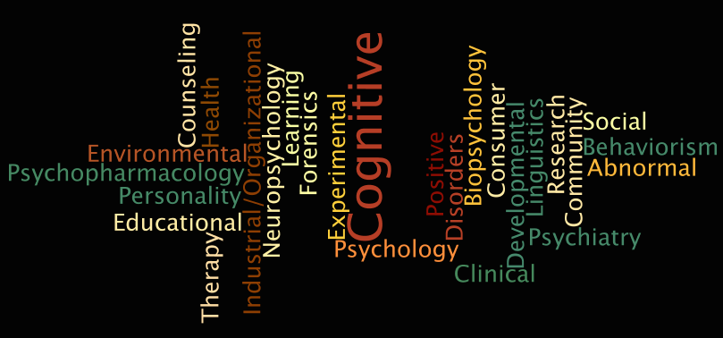
The Many Faces of Psychology
What is Psychology?
What are the different areas of study and specialization?
Notes:
Created by Diane Alonso using Wordle 2/17/15, see http://www.wordle.net/show/wrdl/8524748/Psychology_Areas_of_Study.

Slide 6
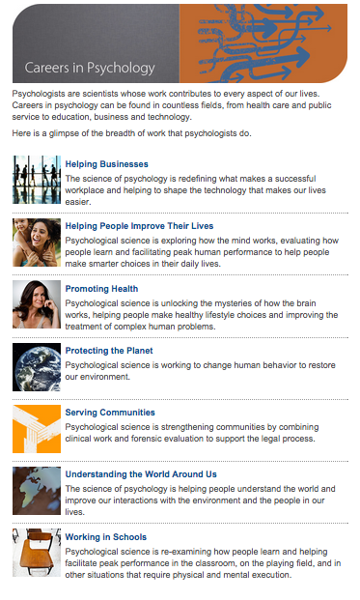
Careers In Psychology
Science in Action
From the APA web site: http://www.apa.org/action/careers/index.aspx

Slide 7
Examples of Types of Psychologists
Clinical psychologists assess, diagnose, and treat mental, emotional, and behavioral disorders.
Health psychologists study how psychological factors affect health and illness.
Neuropsychologists study the relation between the brain and behavior.
Counseling psychologists advise people on how to deal with problems.
Developmental psychologists study the psychological progress and development that takes place throughout life.
Forensic psychologists use psychological principles in the legal and criminal justice system to help judges, attorneys, and other legal specialists understand the psychological aspects of a particular case.
Industrial-organizational psychologists apply psychology to the workplace by using psychological principles and research methods to solve problems and improve the quality of work life.
School psychologists apply psychological principles and techniques to education-related and developmental issues.
Social psychologists study how people’s mindsets and behavior are shaped by social interactions.
From http://www.bls.gov/ooh/life-physical-and-social-science/psychologists.htm#tab-2

Slide 8
From Professionals
Norman Anderson, Ph.D. From the APA: A Passion for Psychology (video)
Here are some others that might be interesting:
  Dr. Eduardo Salas, Ph.D. Organizational Psychologist
    Helping Teams Thrive
  Madeleine Hallé, Ph.D., Performance Psychologist – Sport and Performance Psychology at Work
    Helping Athletes conquer their fears (video)
  Tim Nichols, Ph.D., Research Psychologist
    Research Psychology at Work (video)
  Teri Bourdeau, Ph.D., Clinical Psychologist
    Healthy Families (video)

Slide 9
Path: The Undergraduate
Degree and Beyond…
What is the difference between a Bachelor of Arts (B.A.) and a Bachelor of Science (B.S) degree?
What can you do with a Bachelor’s degree in Psychology?
What can you gain with a Master’s Level Degree?
What can you gain with a Doctoral Level Degree and what is the difference between a Ph.D. and a Psy.D.?

Slide 10
Degrees in Psychology:
Bachelor’s degree
Bachelor’s degree — Bachelor’s degrees in psychology are offered at most colleges and universities and usually require four years of study. This degree can prepare students for the workforce or continued education. People with bachelor’s degrees in psychology can work in many fields; many find jobs in public affairs, education, business, sales, service industries, health, the biological sciences and computer programming. They may also work as employment counselors, interviewers, personnel analysts, probation officers and writers.

Slide 11
B.A. vs. B.S.
The Bachelor of Arts (B.A.) Degree – is designed for students with an interest in human behavior, social and community services, personality theories, developmental issues and a wide variety of other focus areas. There is a wealth of opportunities for students earning the B.A. in psychology — from graduate studies in school counseling to a job working in marketing.
The Bachelor of Science (B.S.) Degree -- is designed for students with an interest in research and the biological aspects of human and animal behavior. Students pursuing careers in medicine, research, health care, public policy, law and a multitude of other fields might want to consider the B.S.
See http://psychology.umbc.edu/ba/ and http://psychology.umbc.edu/bs/
Notes:
Info from UMBC’s Psychology Department’s web site.

Slide 12
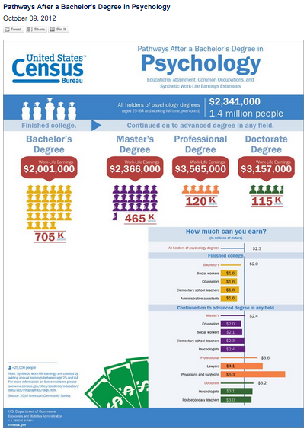
From the US Census Bureau web site http://www.census.gov/library/infographics/psyc_majors.html
Notes:
From http://www.census.gov/library/infographics/liberal_art_majors.html

Slide 13
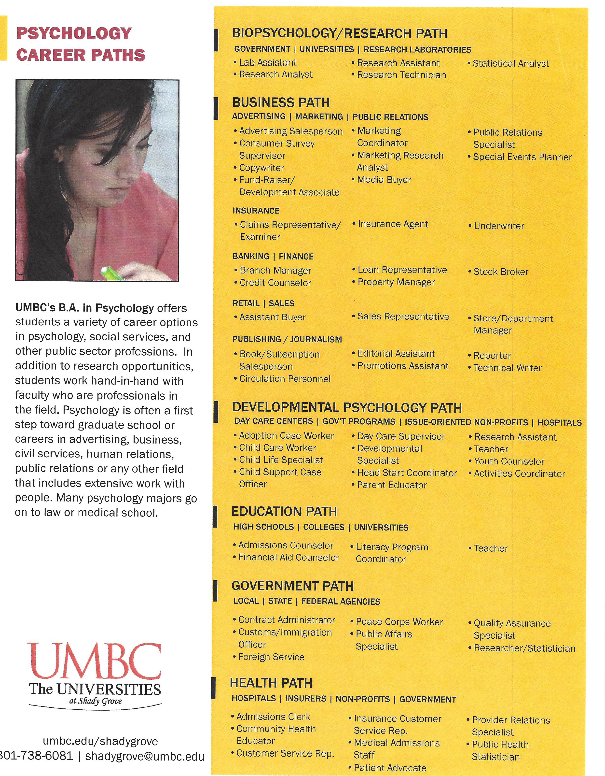
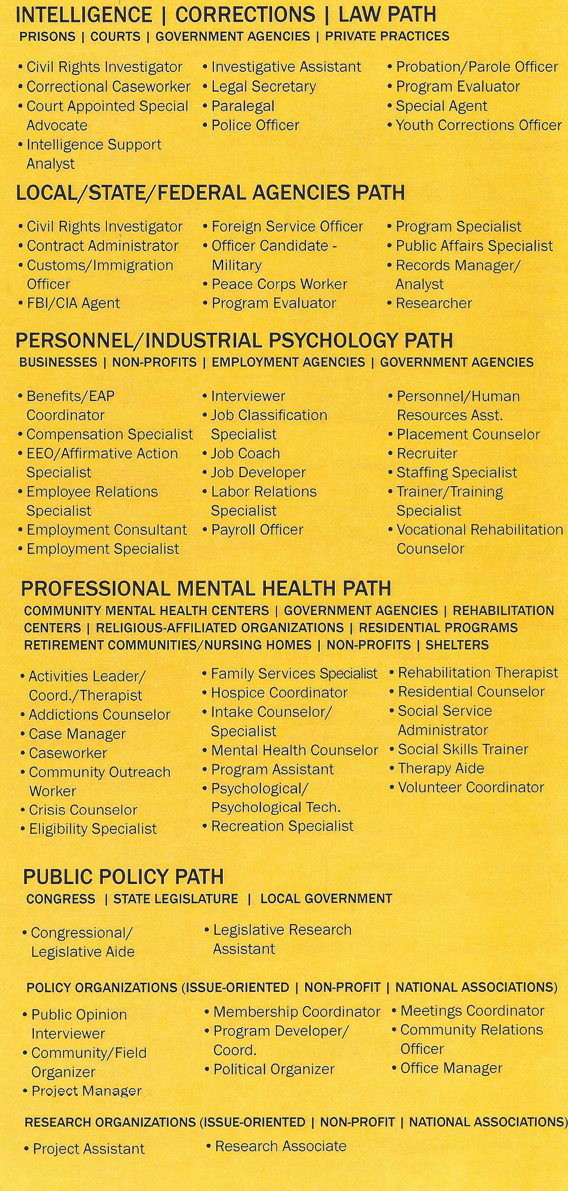

Slide 14
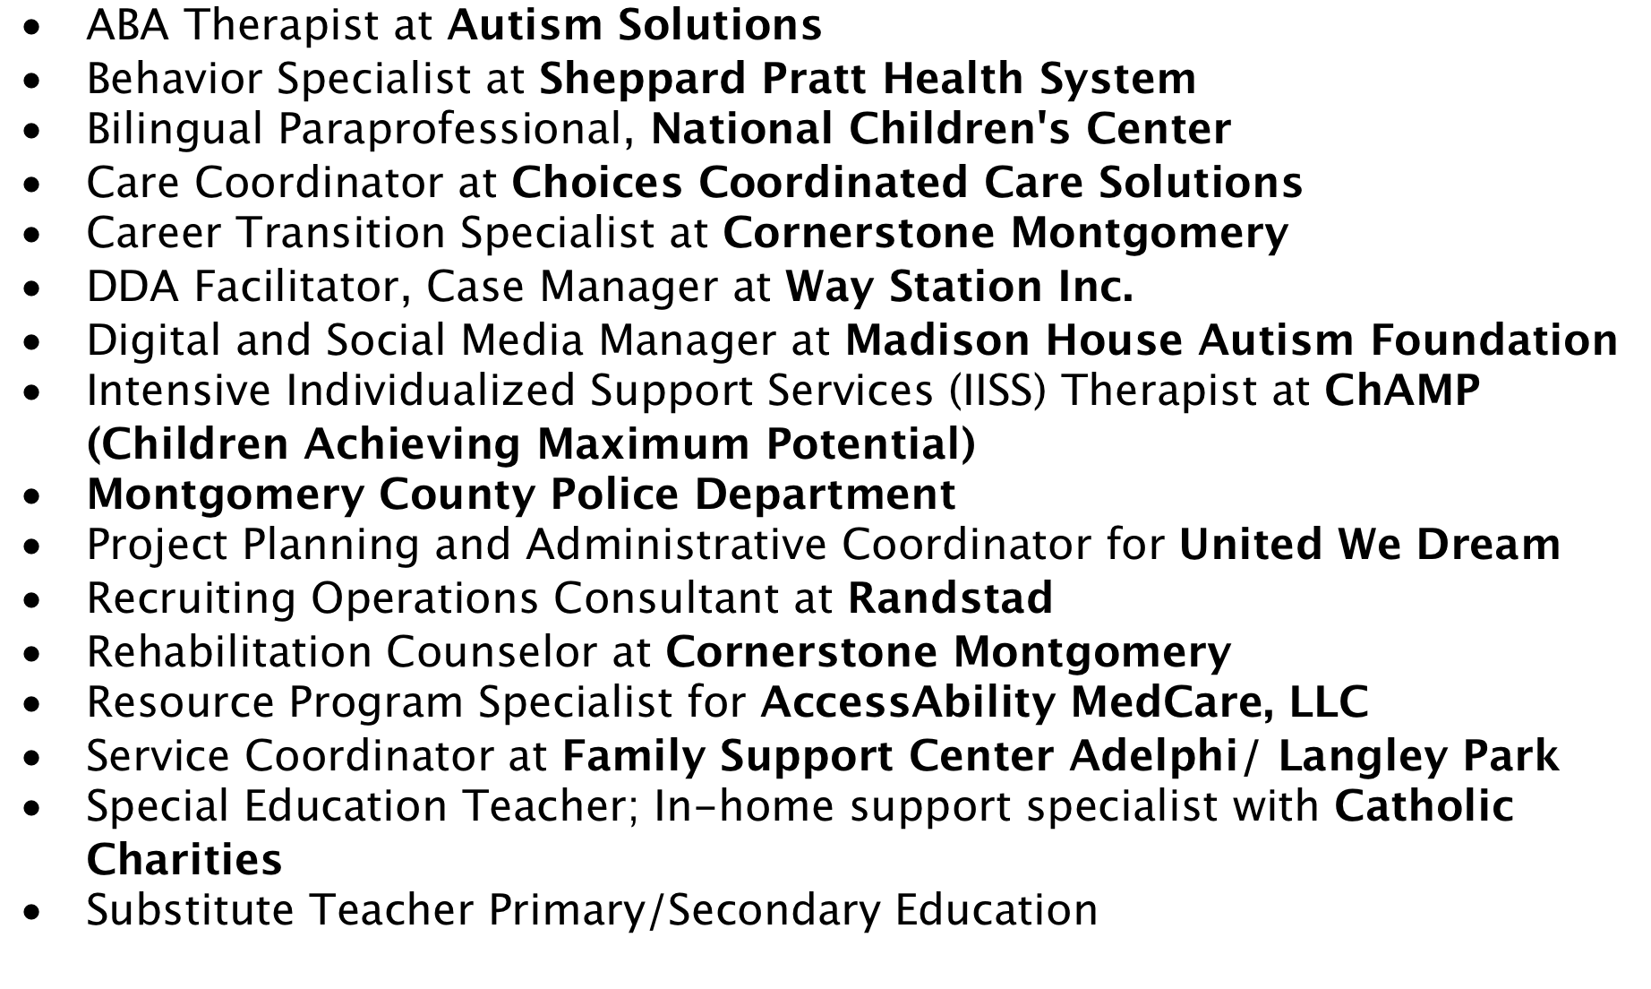
A Sample of Job Placements for
UMBC PSYC @USG Students with a Bachelor’s Degree

Slide 15
Degrees in Psychology:
Master’s Degree
Master’s degree — A master’s degree takes an additional two years of graduate-level coursework and a thesis. While people with a master’s degree can go on to earn a doctoral degree, those with several years of experience in business or industry can obtain jobs in consulting and market research, while others may find jobs in government, universities or in the private sector as counselors, researchers, data collectors and analysts. Most master’s degrees in psychology are awarded in clinical, counseling and industrial and organizational psychology.
From http://www.apa.org/action/careers/facts.aspx

Slide 16
Degrees in Psychology:
Doctoral Degrees
Doctoral degree — Doctoral degrees in psychology include the PhD, the EdD and the PsyD. Each takes about five to seven years to earn. Anyone interested in earning a doctoral degree as a pathway for a career in health services should attend an accredited institution. The PhD tends to be more of a
research-focused degree, while the PsyD is designed for those who want to do clinical work. These degrees often serve as stepping stones to a range of careers in research, justice, space and aeronautics, sports and much more.
From http://www.apa.org/action/careers/facts.aspx
Notes:
Comment on Dissertation for Ph.D. and Note Licensure (to use the title “Psychologist” and to practice independently.:
[For In most states, practicing psychology or using the title of “psychologist” requires licensure or certification.
In all states and the District of Columbia, psychologists who practice independently must be licensed. Licensing laws vary by state and type of position.]

Slide 17

Down the Road – What about Graduate School?
Watch a video in which Dr. Robert Deluty, UMBC Psychology faculty member and Associate Dean of the Graduate School at UMBC, discusses graduate school options (approx. 1 hour)
The link is also available from the UMBC@USG web site at http://www.umbc.edu/shadygrove/psychology/index.php

Slide 18

Plan: Questions to Consider
Starting
off
What is your story?
Why Psychology?
Current Status
What are some of your favorite classes/experiences?
Moving Ahead
Where do you see yourself in 1 year?
How about in 5 years?
What is your ideal career?
What are some of the opportunities you have been involved with while at MC?
How did you get to where you are now?

Slide 19
What can you do to make the most of your opportunities?
The type of job you get depends on many things. Here are a few things to think about:
  Highest degree earned
  Area of Psychology
  Experience
  Who you know (networking)
  Here is some additional information….

Slide 20

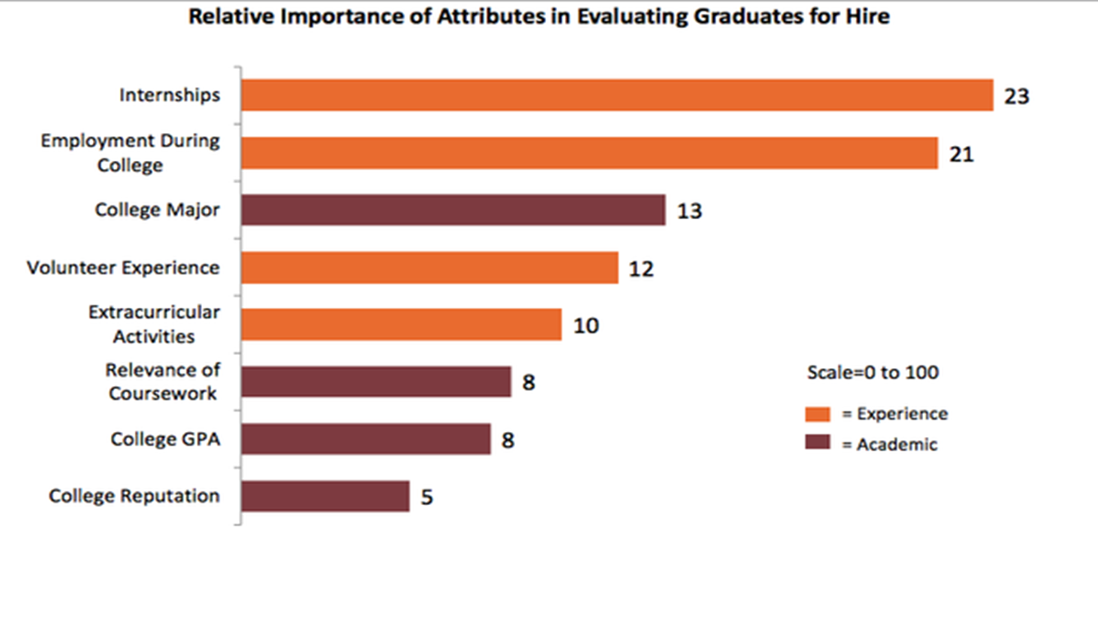

What are Employers Really Looking For?
Notes:
This slide is a combination of two slides from USG’s Career Services presentation to the USG Program Directors on 11/11/15. Courtesy of Dr. Wendelin Donhue.

Slide 21
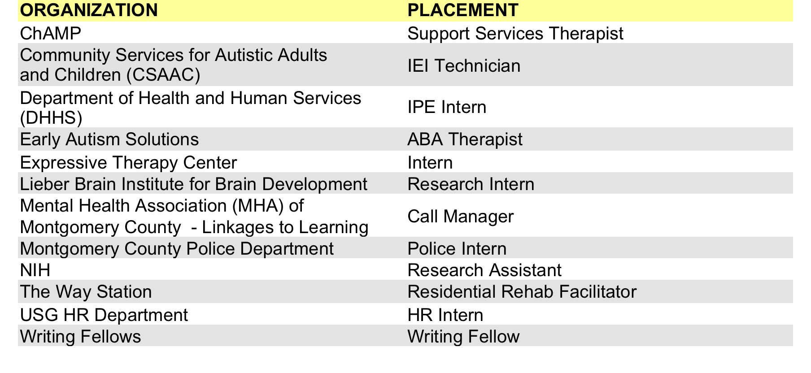
What can YOU do? Get Experience!!!
A sample of Internship Placements for UMBC@USG PSYC Students FA2014-SP2015

Slide 22









Internship Placements for
UMBC PSYC Students at USG

Slide 23
Final Thoughts and Questions…
Passion→Path→Plan
Do something you enjoy and care about.
Experience
Participate in research experiences, internships, and service.
Connections
Network
Be vigilant – be on the lookout for good opportunities.
Find your passion and your pathway – create a plan of action.
Resources
Ask counselors and advisors for advice and information about opportunities.
Use your recommendations.
Use this to figure out what you want and what you don’t want in a career.
Leverage the connections you made in your internships and other experiences.
Join organizations and volunteer ☺
Use the Internet wisely.

Slide 24
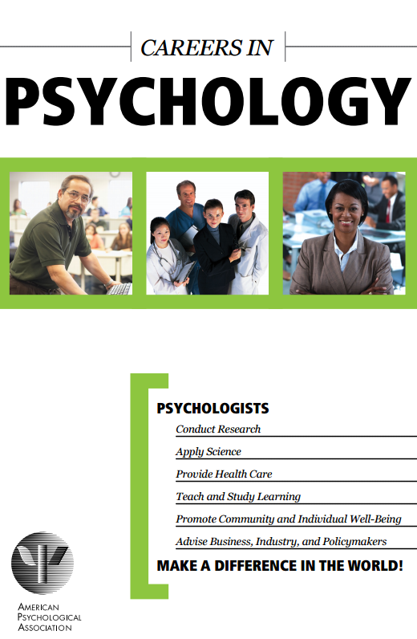

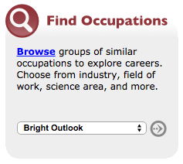
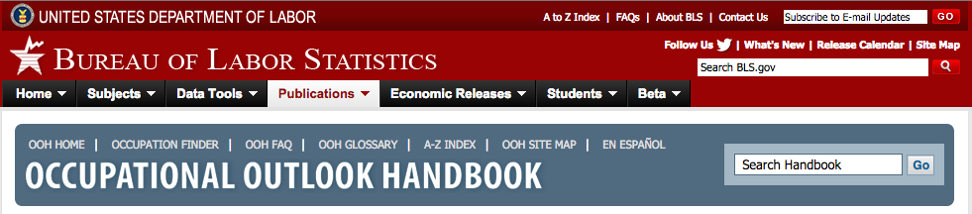
Additional Resources
Careers in Psychology handbook from the American Psychological Association (APA). PDF available at http://www.apa.org/careers/resources/guides/careers.pdf
A searchable database of
types of jobs. Provides KSAs.
https://www.onetonline.org/
Select criteria to see job growth, projected growth rate, and median pay http://www.bls.gov/ooh/
Notes:
Bureau of Labor and Statistics Website's Occupational Outlook Handbook for Psychologists: http://www.bls.gov/ooh/life-physical-and-social-science/psychologists.htm
Question…

